Slide 1
Health Indicators

Slide 2
Brainstorming
“50 children vaccinated for measles”
Is this good or bad?
Why don’t you know?
What can you do with this data to make it meaningful?

Slide 3
Brainstorming: Indicators
What indicators can help you determine if your health facility is performing well in the following areas?
Health status
Service delivery
Resource management

Slide 4
Data elements
Data elements are the raw data (either individual or aggregate) that describe a specific attribute about an entity. They are typically recorded on a survey form, registers or patient forms and reported.
One or more data elements are often combined to calculate an indicator:
Total Malaria cases = <5 yr malaria + >=5 yr malaria
BCG coverage rate = BCG immunized children <1 year total children <1 year

Slide 5
Indicators
Indicators are variables that help to measure changes, directly or indirectly (WHO 1981)

Slide 6
Indicator Definition
An Indicator is….
a variable
that measures
one aspect of a program/project
An appropriate set of indicators includes at least one indicator per significant element of the program or project (input, output, outcome, impact).
Notes:
5
Presentation Notes
An indicator is a variable that measures one aspect of a program or a project. Let’s consider each element of this definition. Indicators are generally used to show that a program activity has caused a change or a difference at the level of the object measured. Thus, we can reasonably expect that the indicator of this change will also vary. The value of the indicator varies between a given, reference level, measured at the start of the intervention, and another value measured after the intervention has had time to produce its impact, when the indicator is again measured.
Second, an indicator is a measurement. It measures the value of the change in units that are significant for the management of the program and comparable to past and future units and values. In other words, the calculation of an indicator established the value of the objective at a given moment using the measurement of an interest factor related to the goals of the PSN programs. Even if the factor is, in and of itself, subjective (the attitudes of a target population, for example), the measurement of the indicator calculates the value objectively at a given moment.
Third, an indicator is focused on a single aspect of a program or project. This can be an input, an output, or a general objective, but the corresponding indicator will be narrowly defined in order to determine the aspect measured as precisely as possible..
For a given project or program in a given context, with specific goals and objectives, a complete and appropriate set of indicators must include at least one indicator per significant element of the intervention.
Additional information
This module is focuses on the indicators of results. Several indicators per result identified within a strategic framework are generally appropriate, but it is just as important not to overload the F/E plan to the point where it becomes so complex that the set of indicators becomes too cumbersome and loses its usefulness for feedback and improving management.

Slide 7
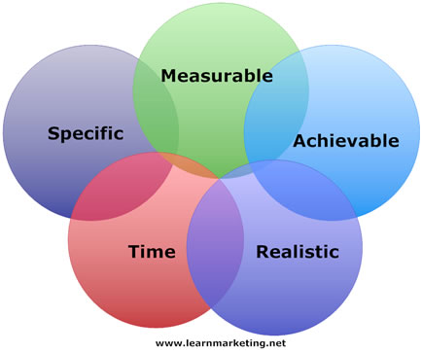
Indicator Definition

Slide 8
Specific – What do you want to achieve, by when, for who, where and how much do you want to achieve?
Measurable – Can you measure the change?
Achievable – Is your goal reached with a reasonable amount of effort?
Realistic – Is it realistically possible using the skills and resources you have available?
Time limited – Can you reach your goal in the allotted time?

Slide 9
Qualities of Good Indicators
Action-oriented
Relevant
Easily generated, measured
Valid: Sensitive & Specific
Reliable
Representative
Understandable
Timely

Slide 10
Rwanda Core Health Indicator list
Service Focus |  | # of indicators
Child health |  | 57
CHW |  | 51
ENVIRONMENTAL HEALTH |  | 10
Essential drugs |  | 2
Financing |  | 6
Geographic Access |  | 2
HIV |  | 33
HR |  | 11
IDSR |  | 7
Infrastructure |  | 4
Lab |  | 6
MALARIA |  | 22
Maternal Health |  | 30
MENTAL HEALTH |  | 4
Nutrition |  | 8
Quality assurance |  | 2
Reproductive Health |  | 26
Resources |  | 10
TB |  | 7
Grand Total |  | 298
298 indicators selected by MOH programs in 2012
191 disease diagnoses (some overlap between Hospitalization, OPD and IMCI)
In addition 200 data elements are collected to calculate indicators

Slide 11
WHO minimum indicator sets
3 types of indicators are key:
Health problem: incidence or prevalence of disease
Health service: provision of health services to prevent or treat the disease
Critical resource: availability of drugs, trained health workers or other material/equipment required to provide health service

Slide 12
Cycle de Transformation de Données en Action
Développer et mettre à jour le plan
Evaluer les résultats
Prioriser et Agir
Analyser les tendances
Comparer avec les normes
Comparer avec des cibles
Créer des hypothèses
Demander des précisions!
Décision/
Action
Identifier le paquet minimum de données
Exploiter les sources existantes
Améliorer le circuit
Contrôler la qualité
Interprétation
Collecte
Préparer des rapports, tableaux et graphiques
Partager des informations avec des audiences cibles
Présentation
Traitement
Saisir les données
Compiler les données
Calculer des indicateurs

Slide 13
Selected health sector target populations and indicators

Slide 14
Expressing an indicator
An indicator is usually expressed in numerical form:
Absolute number
ratio: x:y (commonly in ratio the value of x and y are completely independent)
percentage/proportion: X/Y (the values of X are included in the value of Y)
average
Notes:
6

Slide 15
Expressing an indicator
Rate: is a kind of proportion with a time dimension: it measures the occurrence of an event in a population over time
Ratio: shows the relative size of two different values, can be expressed as 1:2 or as 50% (e.g. sex ratio 52:50)
Notes:
6

Slide 16
Catchment area population
According to national norms:
District hospital should serve about 250,000 inhabitants
Health center should serve about 20,000 inhabitants
Catchment area population is a key concept in public health. Health facilities are responsible not only for providing curative care but for health promotion and disease prevention in their catchment area

Slide 17
How to determine Catchment Population?
Rural areas: the objective is for the population to be within walking distance (5 km) of a primary health care facility
Urban areas: in dense population centers distance is not an issue, rather people often choose facilities based on other criteria (proximity to workplace, religious affiliation, quality of care)

Slide 18
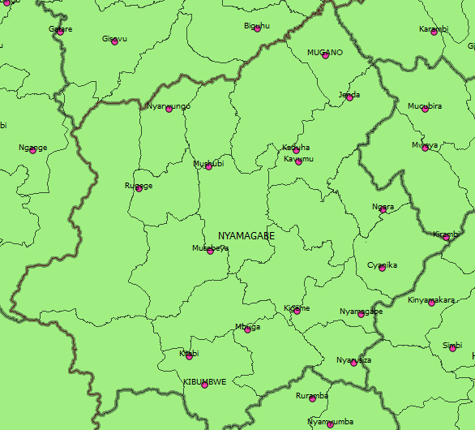
Geographic Access
Note that some admin sectors have more than one HC while others have none

Slide 19
Rural Areas
Each Health Center lists the villages from which their patients come from the OPD register.
Populations from all of these villages are assigned to the health centers
If two health centers serve the same village then that population is divided between the two.
If there are unserved villages, districts must assign them to specific health facilities

Slide 20
Urban Areas
In an urban area, there are often many health facilities and transport is easy. People select their service provider based on many factors other than geography
Once a year, calculate the total number of OPD visits for each facility in the district
Divide the total population of the district between all of the health centers in proportion to the OPD

Slide 21
Projecting population
A simple way to project population by year is to use the straight line population projection formula:
PopZero= population at start year
Growthrate= annual population growth rate (2.6%)
YearN= year to which you want to project population
YearZero= start year (2002)

Slide 22
Selected Indicator denominator parameter
Number | Parameter | Value | Used for
1 | Population growth rate | 2.6% | Projecting population
2 | Children 0 - 11 months | 4.10% | Vaccination coverage
3 | Children 1 - 4 years | 12.10%
4 | Children under 5 years | 16.20% | Nutrition surveillance
5 | Expected Pregnancies | 4.10% | PMTCT,CPN,Deliveries
6 | Women of reproductive age | 23.60% | Family Planning
7 | Total population 2008 | 9,831,501 | OPD utilisation
8 | Total population 2009 | 10,117,029 | OPD utilisation
9 | Total population 2010 | 10,412,820 | OPD utilisation
10 | Total population 2011 | 10,718,379 | OPD utilisation
11 | Total population 2012 | 10,537,222 | OPD utilisation
12 | Total population 2013 | 10,817,006 | OPD utilisation

Slide 23
Selected health service coverage rates
Antenatal care coverage rate: # of new registrations for CPN (ANC)/# of expected pregnancies (4.1%)
Measles vaccination coverage rate: # of measles vaccinations given/# of children 0-11 months (4.1%)
Family planning coverage rate: # of Users at end 1 month (do not add up months – this is cumulative data)/# of women of Reproductive age (23.6%)
Nutrition surveillance coverage rate: # of children < 5 weighed during 1 month/# of children <5 years (16.2%)

Slide 24
Additional key health indicators
Maternal mortality ratio: # of maternal deaths/# of live births*100,000
Proportional morbidity rate: # of new cases of specific disease/total # of OPD new cases seen
Disease specific case fatality rate: # of patients with disease X who died/# of patients with disease X admitted
Average duration of hospitalization: Total days hospitalisation for discharged patients/# of patients discharged (died, cured, referred, counter-referred,absconded)

Slide 25
Selected Resource indicators
Population/Doctor ratio:
Total population
Number of Nurses
Population/Nurse ratio:
Total population
Number of Nurses
Months of stock of drugs:
Stock at end of period
Quantity consumed in 1 month

Slide 26
Individual Exercises
Calculate Projected District Populations for future years
Calculate CPN Coverage Rate By District
Calculate proportional morbidity rate for Malaria OPD at your health facility
Calculate the months of stock available for IUDs and Coartem in 2 health centers
Calculate average duration of stay for one district hospital

